Slide 1
5. GC in Non-linear time-series: Dynamics System Representation(ODEs) Machine Learning Models(NN)
Notes:
Beyond the analysis of discrete-valued time series, there are a range of other scenarios where the relationships of GC face challlege,

Slide 2
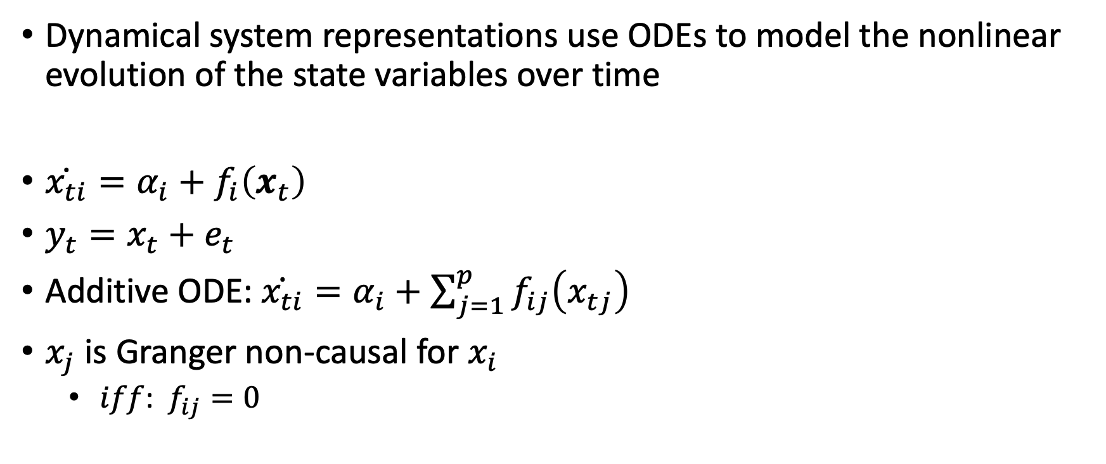
5.1 ODE Representation – Flexible for Nonlinear Dynamics
Dynamical system representations use ODEs to model the nonlinear evolution of the state variables over time
$\dot{x_{ti}}=α_{i}+f_{i}\left(x_{t}\right)$
$y_{t}=x_{t}+e_{t}$
Additive ODE: $\dot{x_{ti}}=α_{i}+\sum_{j=1}^{p}{f_{ij}\left(x_{tj}\right)}$
$x_{j}$ is Granger non-causal for $x_{i}$
$iff$: $f_{ij}=0$
Notes:
TS as discrete sampling representations Of a Dynamical system
Dynamical system:
fi : Rp
→ R is a function mapping the current state of all variables to the change in x
Observaton y is x + mean-zero additive noise e
However, they are limited to additive interaction mechanisms.(require knowing the explicit form of ODE

Slide 3
5.2 Special Focus: Machine Learning Models (MLPs, RNNs, LSTMs)
Notes:
. A promising alternative:
Neural networks can represent complex, nonlinear, and nonadditive interactions between inputs and outputs.

Slide 4
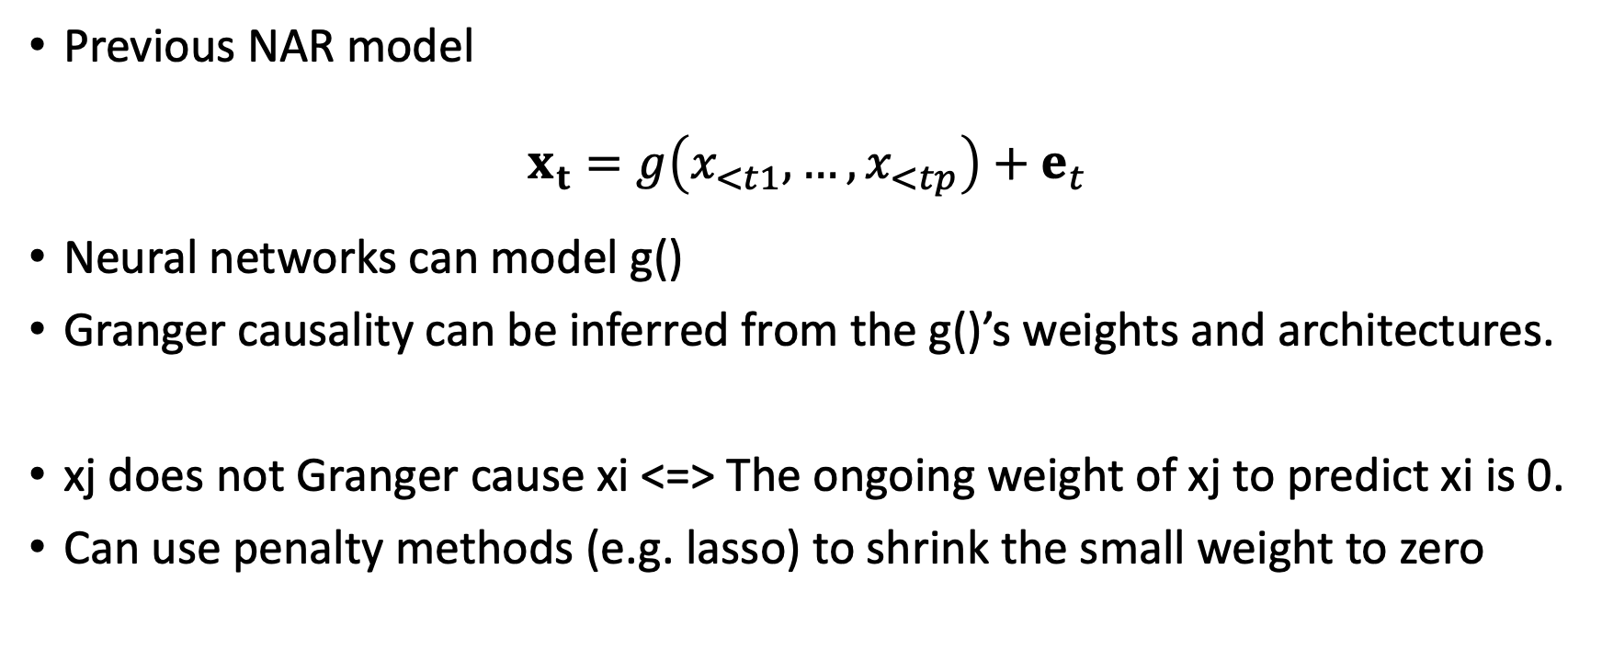
5.2.1 General Model Settings
Previous NAR model
$$x_{t}=g\left(x_{<t1},…,x_{<tp}\right)+e_{t}$$
Neural networks can model g()
Granger causality can be inferred from the g()’s weights and architectures.
xj does not Granger cause xi <=> The ongoing weight of xj to predict xi is 0.
Can use penalty methods (e.g. lasso) to shrink the small weight to zero
Notes:
Consider a nonlinear autoregressive (NAR) model:
forecasting multivariate time series given their past
We can modeling g using neural networks
It can either be an MLP with inputs x<t = x(t−1):(t−K), for some given lag K, or a recurrent network, like an LSTM, that does not require specifying the lag order.
use penalty methods (e.g. lasso) which is suitable for specific model to

Slide 5
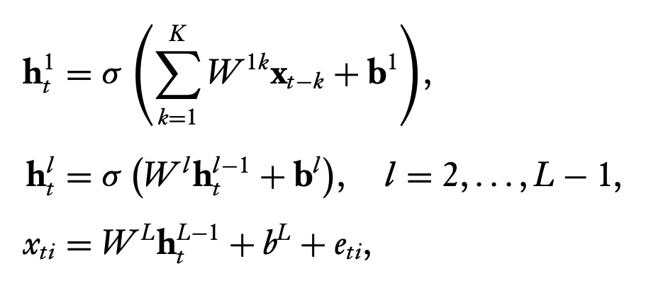
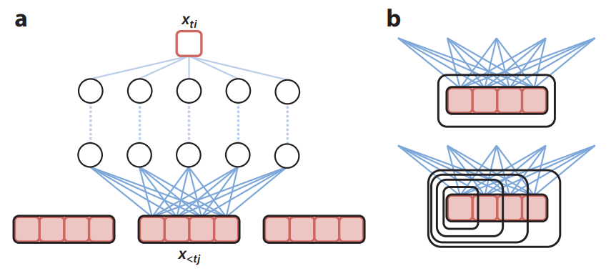
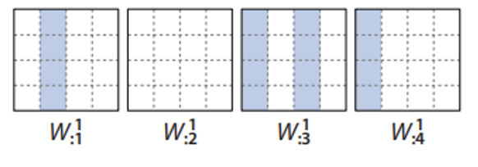
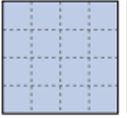
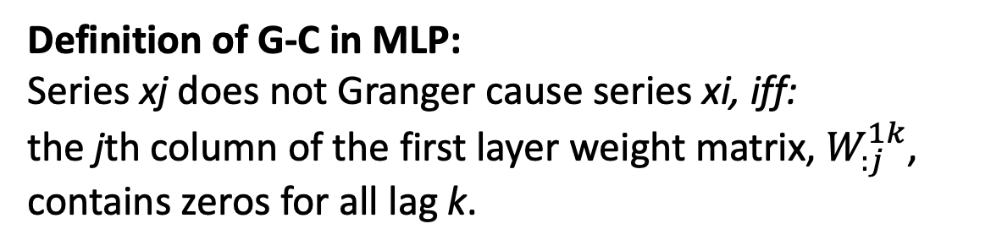
5.2.2 Multilayer Perceptrons (cMLPs)
In the MLP model, for each output xi at t
Definition of G-C in MLP:
Series xj does not Granger cause series xi, iff:
the jth column of the first layer weight matrix, $W_{:j}^{1k}$, contains zeros for all lag k.
Non Granger Causality of x2 on xi
Lag= 1. 2. 3. 4
Neuron= 1
2
3
4
first layer weight
1st layer param
of 1st input, x1
1st layer param
of 2nd input, x2
Notes:
Define gi via an MLP with L − 1 layers
Given lag k: To predict i-th timeseries at time k, we use past k times data,
we further decompose the weights at the first layer across time lags,
if the first layer weight matrix,W 1k j , contains zeros for all lag k, then x<tj does not influence the hidden unit ht 1 and thus the output xti.
Following Definition 1, we see that gi—which is implicitly defined through the hidden layers—is then invariant to x<tj.

Slide 6
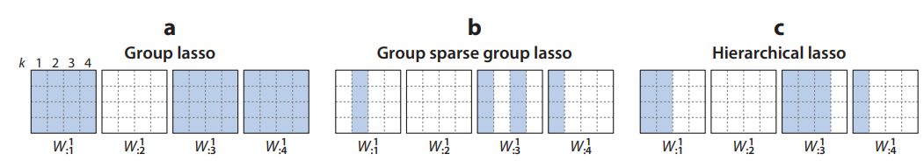
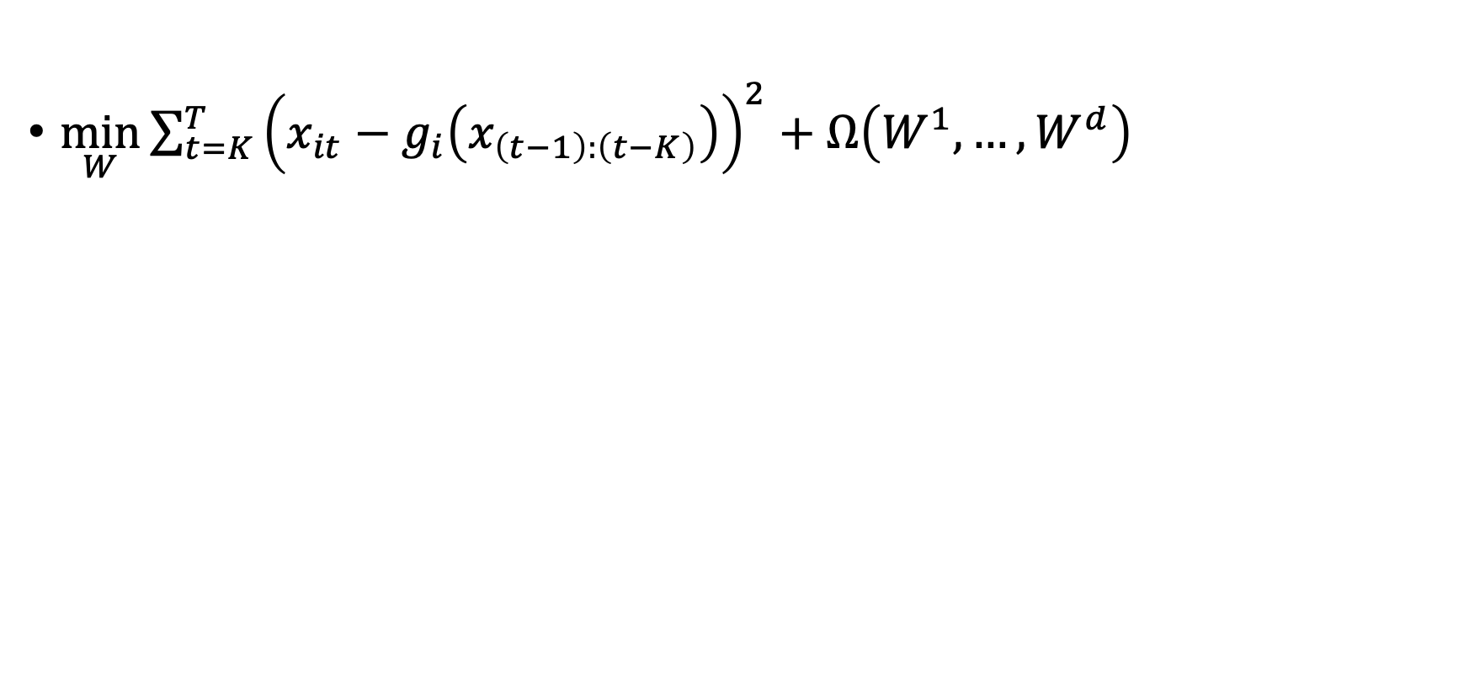
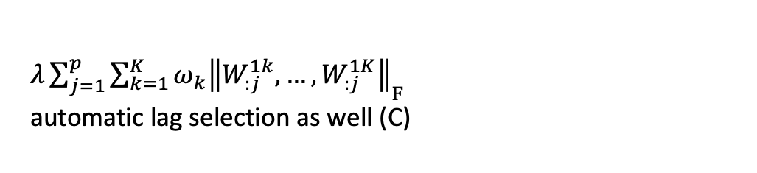
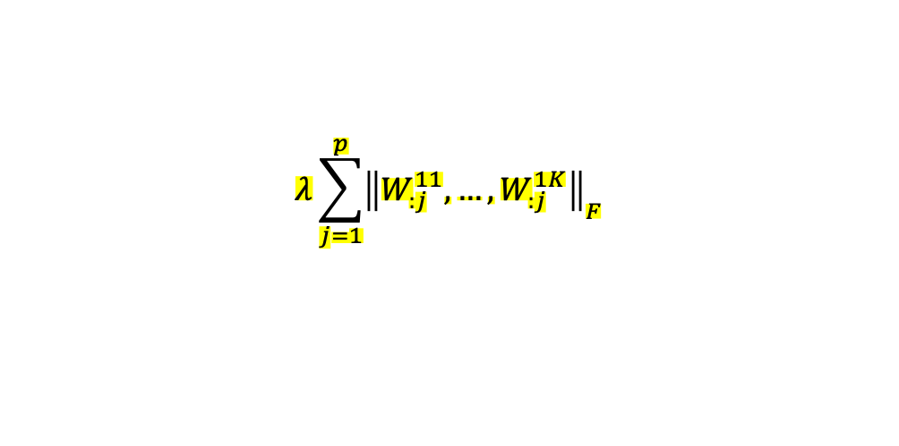
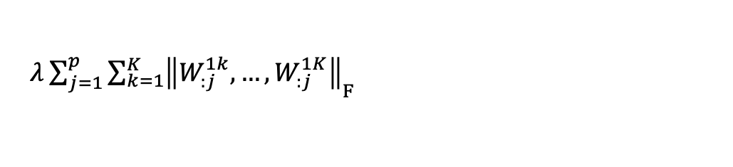
Various penalty selections
Group lasso penalty
penalizes the nested set
of outgoing weights
$\min_{W}{\sum_{t=K}^{T}{{\left(x_{it}−g_{i}\left(x_{\left(t−1\right):\left(t−K\right)}\right)\right)}^{2}+Ω\left(W^{1},…,W^{d}\right)}}$
Hierarchical lasso penalty
penalizes higher lags more
$$λ\sum_{j=1}^{p}{{\left\|W_{:j}^{11},…,W_{:j}^{1K}\right\|}_{F}}$$
$λ{\sum_{j=1}^{p}{\sum_{k=1}^{K}{\left\|W_{:j}^{1k},…,W_{:j}^{1K}\right\|}}}_{F}$
$λ{\sum_{j=1}^{p}{\sum_{k=1}^{K}{ω_{k}\left\|W_{:j}^{1k},…,W_{:j}^{1K}\right\|}}}_{F}$
automatic lag selection as well (C)
sum
sum
sum
Norm F
Norm F
Norm F * w1
Lag=
1st layer parameter
of input ts x1
1st layer parameter
of input ts x2
Notes:
Thus, analogously to the VAR case, we may select for Granger causality by applying a group penalty to the columns of the W1k matrices for each gi,

Slide 7

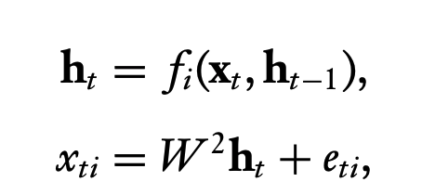
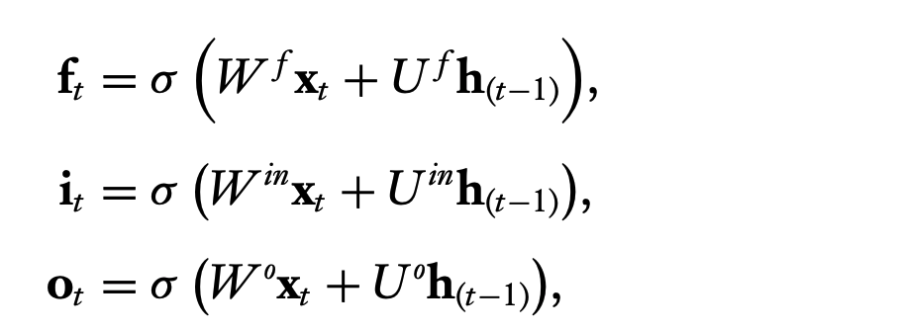
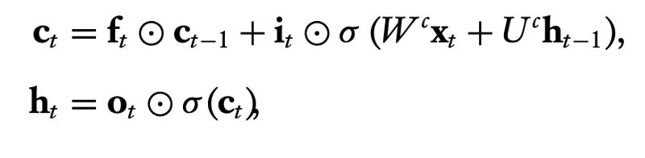
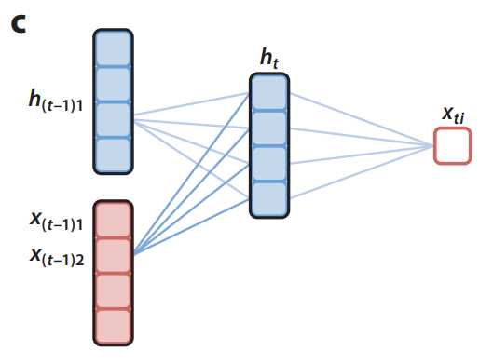
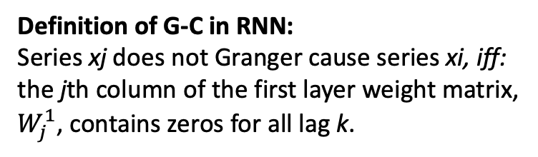
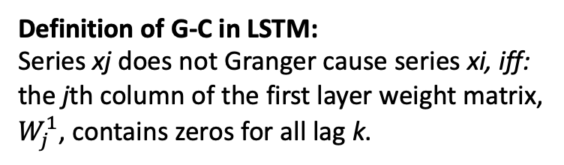
5.2.3 RNN and LSTM
Definition of G-C in RNN:
Series xj does not Granger cause series xi, iff:
the jth column of the first layer weight matrix, $W_{j}^{1}$, contains zeros for all lag k.
Definition of G-C in LSTM:
Series xj does not Granger cause series xi, iff:
the jth column of the first layer weight matrix, $W_{j}^{1}$, contains zeros for all lag k.
$$U_{ }^{1}$$
$$W_{:j=2}^{2}$$
$$W_{j=2}^{1}$$
first layer weight
Notes:
We can also apply the notion of GC to RNN.
In RNN model, at time t-1 when we have a new input xt-1, we updated the hidden state h.
Becuase the hidden state is updated recursively.
Therefore, if every time, the j-th the new information have no effect on the hidden state, then in all, the j-th timeseiroes xj does not GC xi.
Lstm:
The input (it), forget (ft), and output (ot) gates
control how each component of the cell state (ct) is updated and then transferred to the hidden
state (ht) used for prediction.
the full set of first layer weights, W1 controls how the past time series affect the hidden representation update and thus the prediction of xti
We check the first layer weight of input W to see if j-th columns contains all zeros.

Slide 8
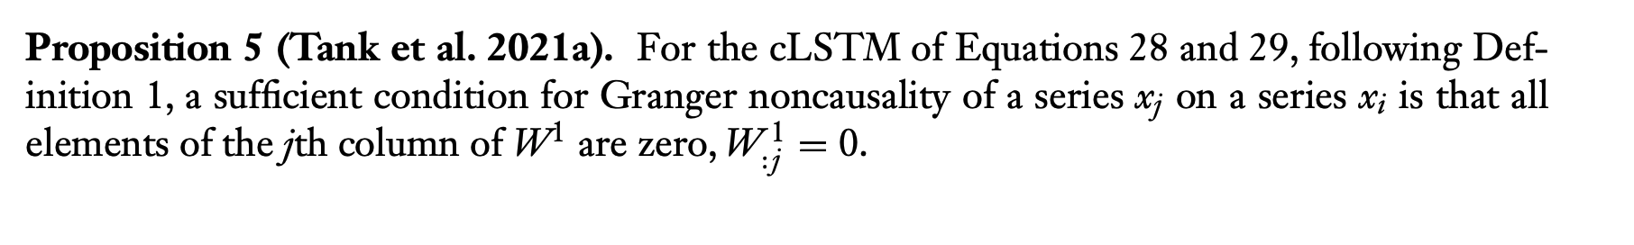
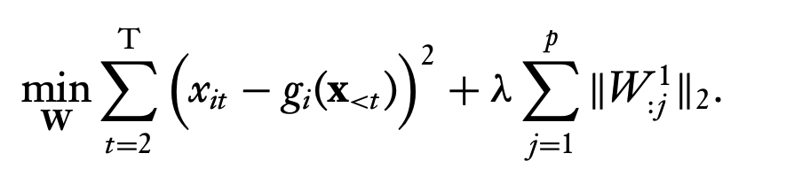
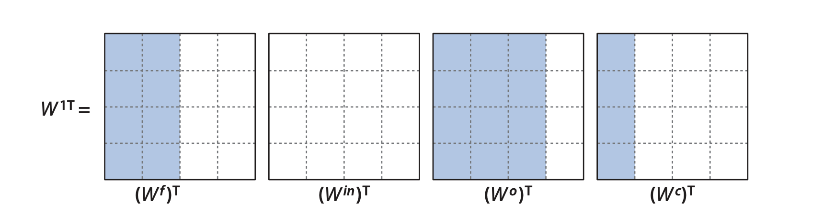
5.2.3 RNN and LSTM
For larger λs, many columns of W1 will be zero, leading to a sparse set of Granger causal connections
Example of group sparsity patterns in a cLSTM with H = 4 and p = 4. Due to the group lasso penalty on the columns of W, the W f , W in, W o , and Wc matrices share the same column sparsity pattern
Notes:
We will show in application part how the lambda will affect the variable selection

